Slide 1
Paris 2024 Planning Details

Slide 2
Team Timeline
Opening Ceremonies
Aug 28
Closing Ceremonies
Sept 8
TUWE @ Athletica
Aug 21
Quarter Finals
Sept 4/5
Semi- Final
Sept 6
W Medal
Sept 8
Train @ Athletica
Aug 18-21
Train @ Village
Aug 22-28
Preliminary Rounds
Aug 29 – Sept 2
Arrive Athletica
Aug 18
Travel To Village Aug 21
Depart USA
Aug 17
Semi- Final
Sept 5
M Medal
Sept 7
Quarter Finals
Sept 3/4
Depart Paris
Sept 9
Team Photoshoot @ Venue Aug 24-26

Slide 3
Departure
Each team to depart through a single airport stateside

Slide 4
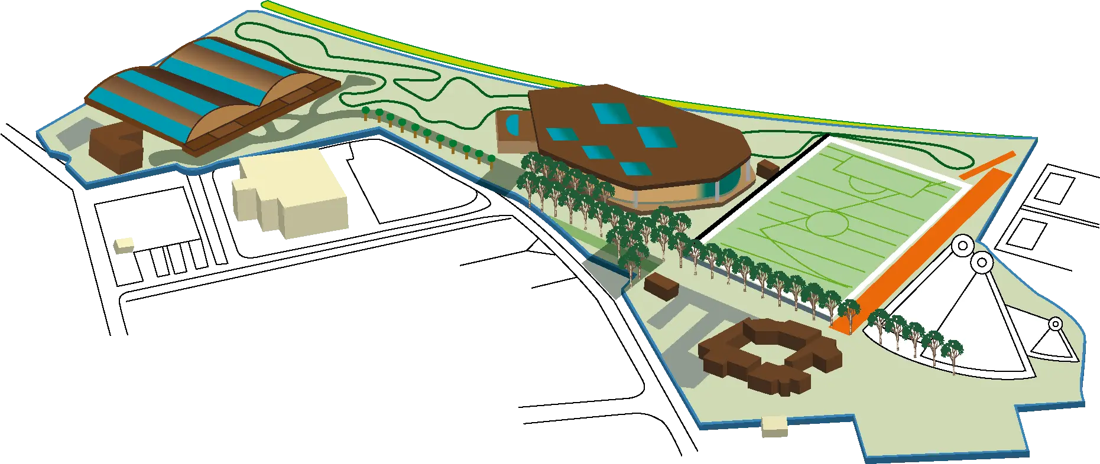
Athletica Team USA HPC
USOPTC Chef Support
Sports Med & Sport Science
20-40 min from CDG
TUWE

Slide 5
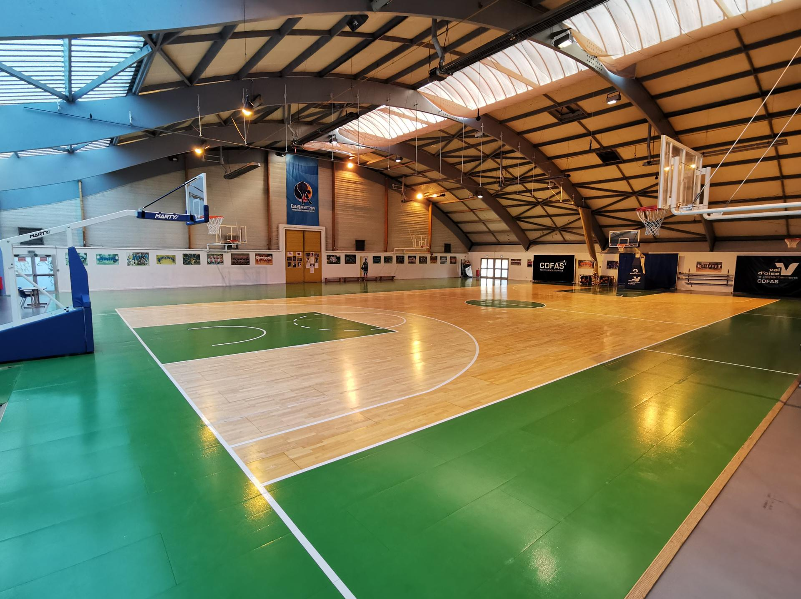
Athletica (formerly CDFAS)

Slide 6
Athletica (formerly CDFAS)
Double occupancy rooms
Air Conditioned
Sit-Volleyball will also be on site
Athlete lounge

Slide 7
Athletica (formerly CDFAS)

Slide 8
Athletica to the village
20-40 minutes

Slide 9
Venues Map

Slide 10
Venues Map

Slide 11
Venues Map

Slide 12
The Village

Slide 16
Team USA Building
Transportation
Training Venue
Dining Hall

Slide 17
Bercy Arena

Slide 18
Bercy Arena
15,000 Seat Capacity
18km / 11miles from the Village
Served by Bercy station (metro lines 6 & 14) and Paris Gare de Lyon (RER lines A & D, train line R, metro line 1).

Slide 19
Apparel Plan
Can’t wear jerseys before games –per USAB & NIKE
Game uniform distributed on ground in Paris via staff
Supplemental package for friendlies -May
2 sets of each color
Names?
Try-on –June camp
Selection jerseys will be classification and training jerseys

Slide 20
Marketing & Comms Plan
Team USA Media Summit – April 15-17
Athlete Spotlights
Media Training with USOPC
Local media
Media Guide

Slide 21
Friends & Family Plan
Tickets 2x / athlete per game
NWBA has a set of tickets for athletes / families to purchase for games
This is still in development

Slide 22
Planning for Heat

Slide 23
Public Relations
Local wheelchair basketball group

Slide 24
USA HOUSE

